Slide 1

Traffic Crash Analytics & Safety Intelligence Platform
Shruti Kinalekar

Slide 2
Objective
To transform structured traffic crash data into meaningful business insight.
Using advanced SQL querying and Python-Streamlit integration
To cover various aspects, including high-risk locations, peak crash times, contributing causes, and environmental impact.

Slide 3
Data Description
Dataset Information
​Dataset Name: Chicago Traffic Crashes
​Source: Chicago Data Portal
​Volume: 600,000+ records
​Time Range: 2015 – Present

Slide 4
Problem Statement
Traffic crash data contains valuable insights that can help improve road safety, optimize emergency response, and support policy decisions. However, extracting meaningful insights from large-scale structured data requires strong SQL and analytical skills.

Slide 5

Key Features
Database Management:
Data loading and exploration using MySQL.
​Advanced SQL Analysis:
Implementation of complex queries, including:
​Aggregations and Groupings.
​Window Functions (e.g., ROW_NUMBER(), RANK(), LAG()).
​Common Table Expressions (CTEs).
​Joins and subqueries
Interactive Dashboard:
A Streamlit application that showcases SQL results in a clean, table-based format with corresponding business insights.

Slide 6
Steps Followed
Received pre-cleaned and structured dataset of traffic crashes.
Analyze crash data using advanced SQL techniques
Identify patterns, trends, and risk factors
Generate business insights from structured data
Step 1
Step2
Generating Queries and Analyzing Outcomes.
Step3
Creating CSV of
Usecase , Query , SQL Statement and Analysis.
Step4
Showcasing results using Streamlit interface.
Uploading Data to MySQL
6

Slide 7
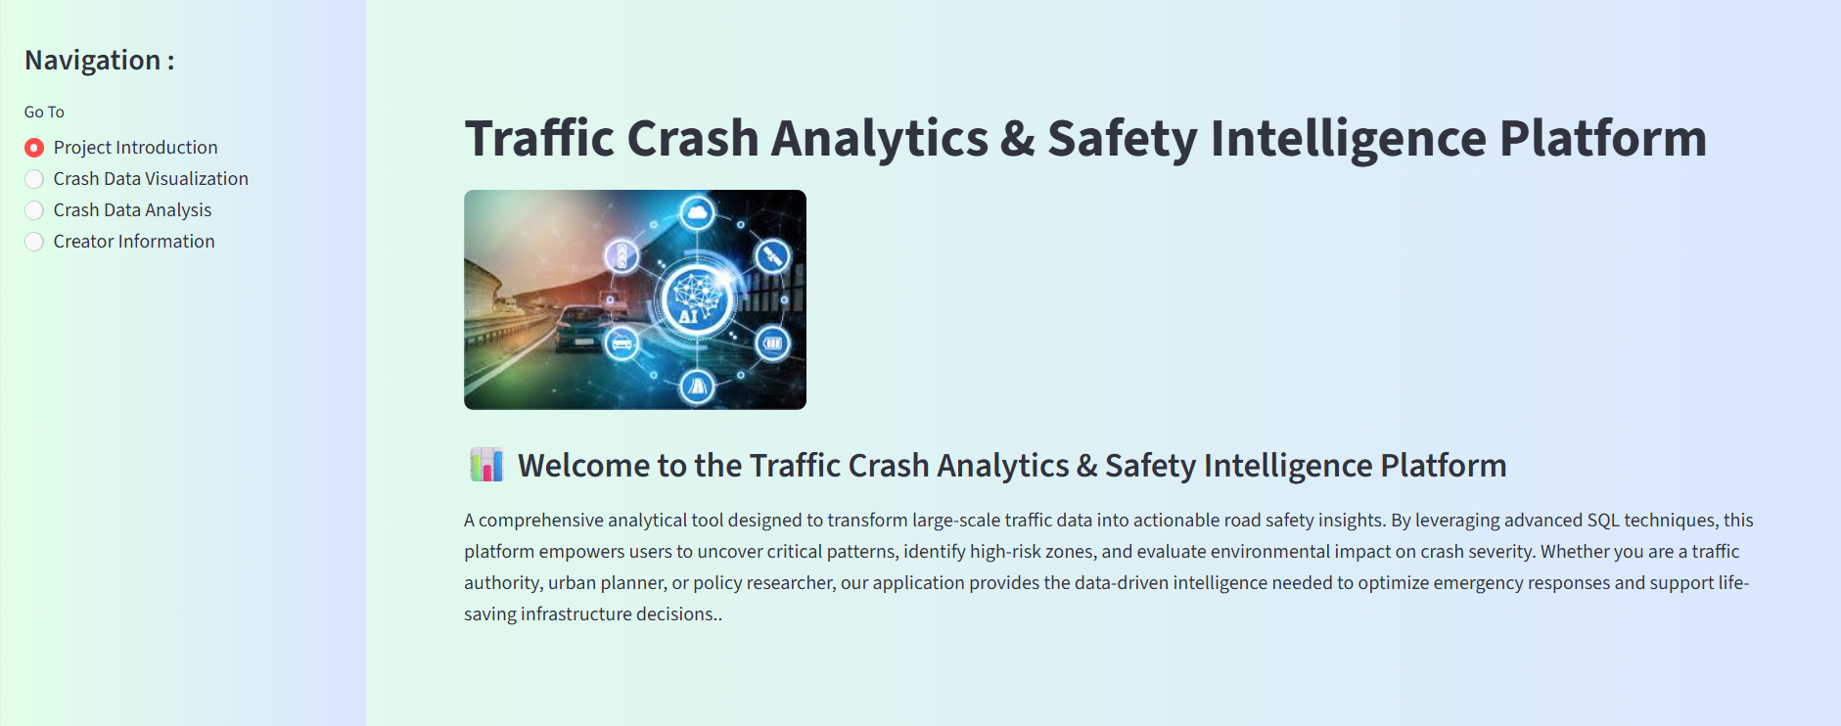
StreamLit Interface
Platform to query, filter and analyze Traffic Crash Data.
Chart Visualization for deeper understanding.
Business Insights based on query Data.
7

Slide 8
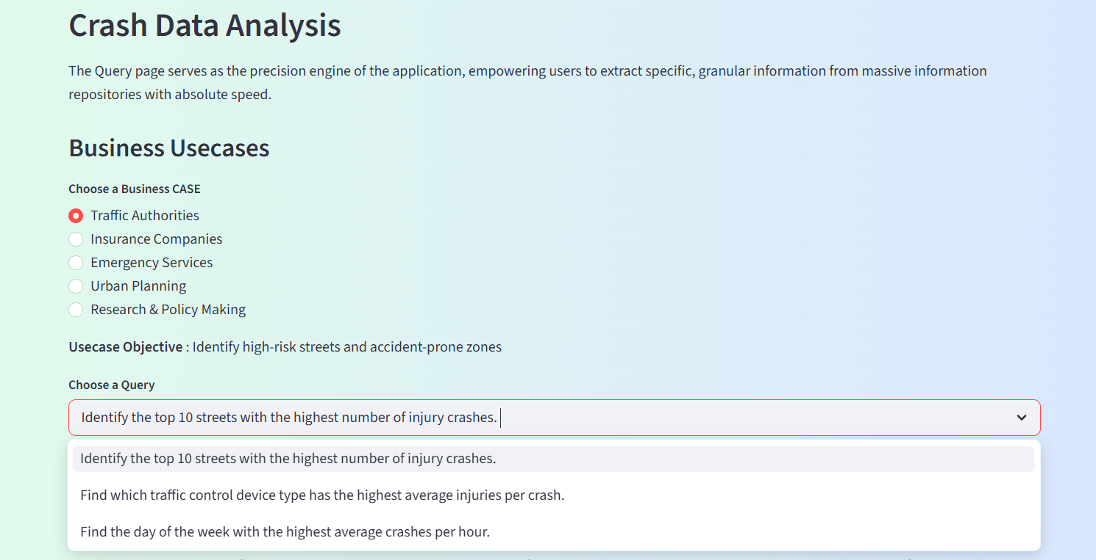
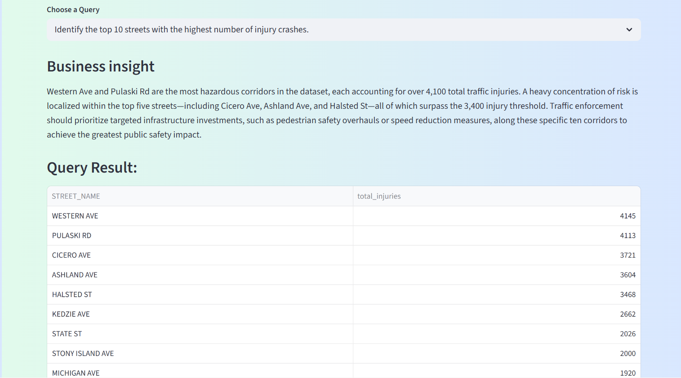
Crash Data Analysis
The Query page serves as the precision engine of the application, empowering users to extract specific, granular information from massive information repositories with absolute speed.
8

Slide 9
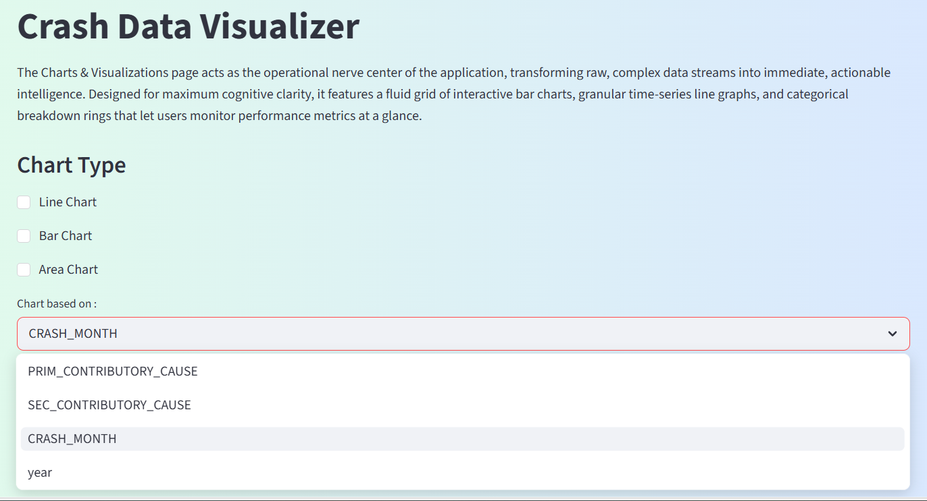
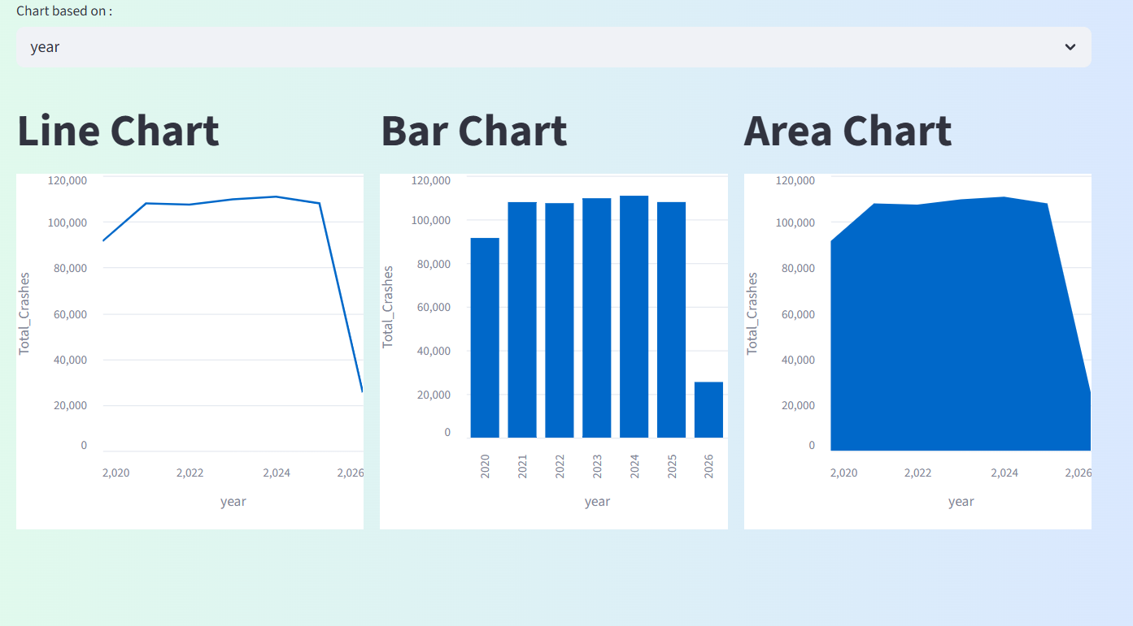
Crash Data Visualization
The Charts & Visualizations page acts as the operational nerve center of the application, transforming raw, complex data streams into immediate, actionable intelligence. Designed for maximum cognitive clarity, it features a fluid grid of interactive bar charts, granular time-series line graphs, and categorical breakdown rings that let users monitor performance metrics at a glance.

Slide 10
Business Impact
This platform enables stakeholders to:
​Traffic Authorities: Identify high-risk streets and accident-prone zones.
​Insurance Companies: Analyze factors contributing to high-severity crashes.
​Emergency Services: Evaluate response effectiveness using time-based data.
​Urban Planning: Understand the impact of road types and conditions.
​Research & Policy Making: Study crash trends and contributing causes.
10

Slide 11
Thank you
Shruti Kinalekar
Email : shrutimk1306@gmail.com
Github : ShrutiKinalekar/Traffic_Crash_Analysis_Python_MySQL_Streamlit

